Slide 1
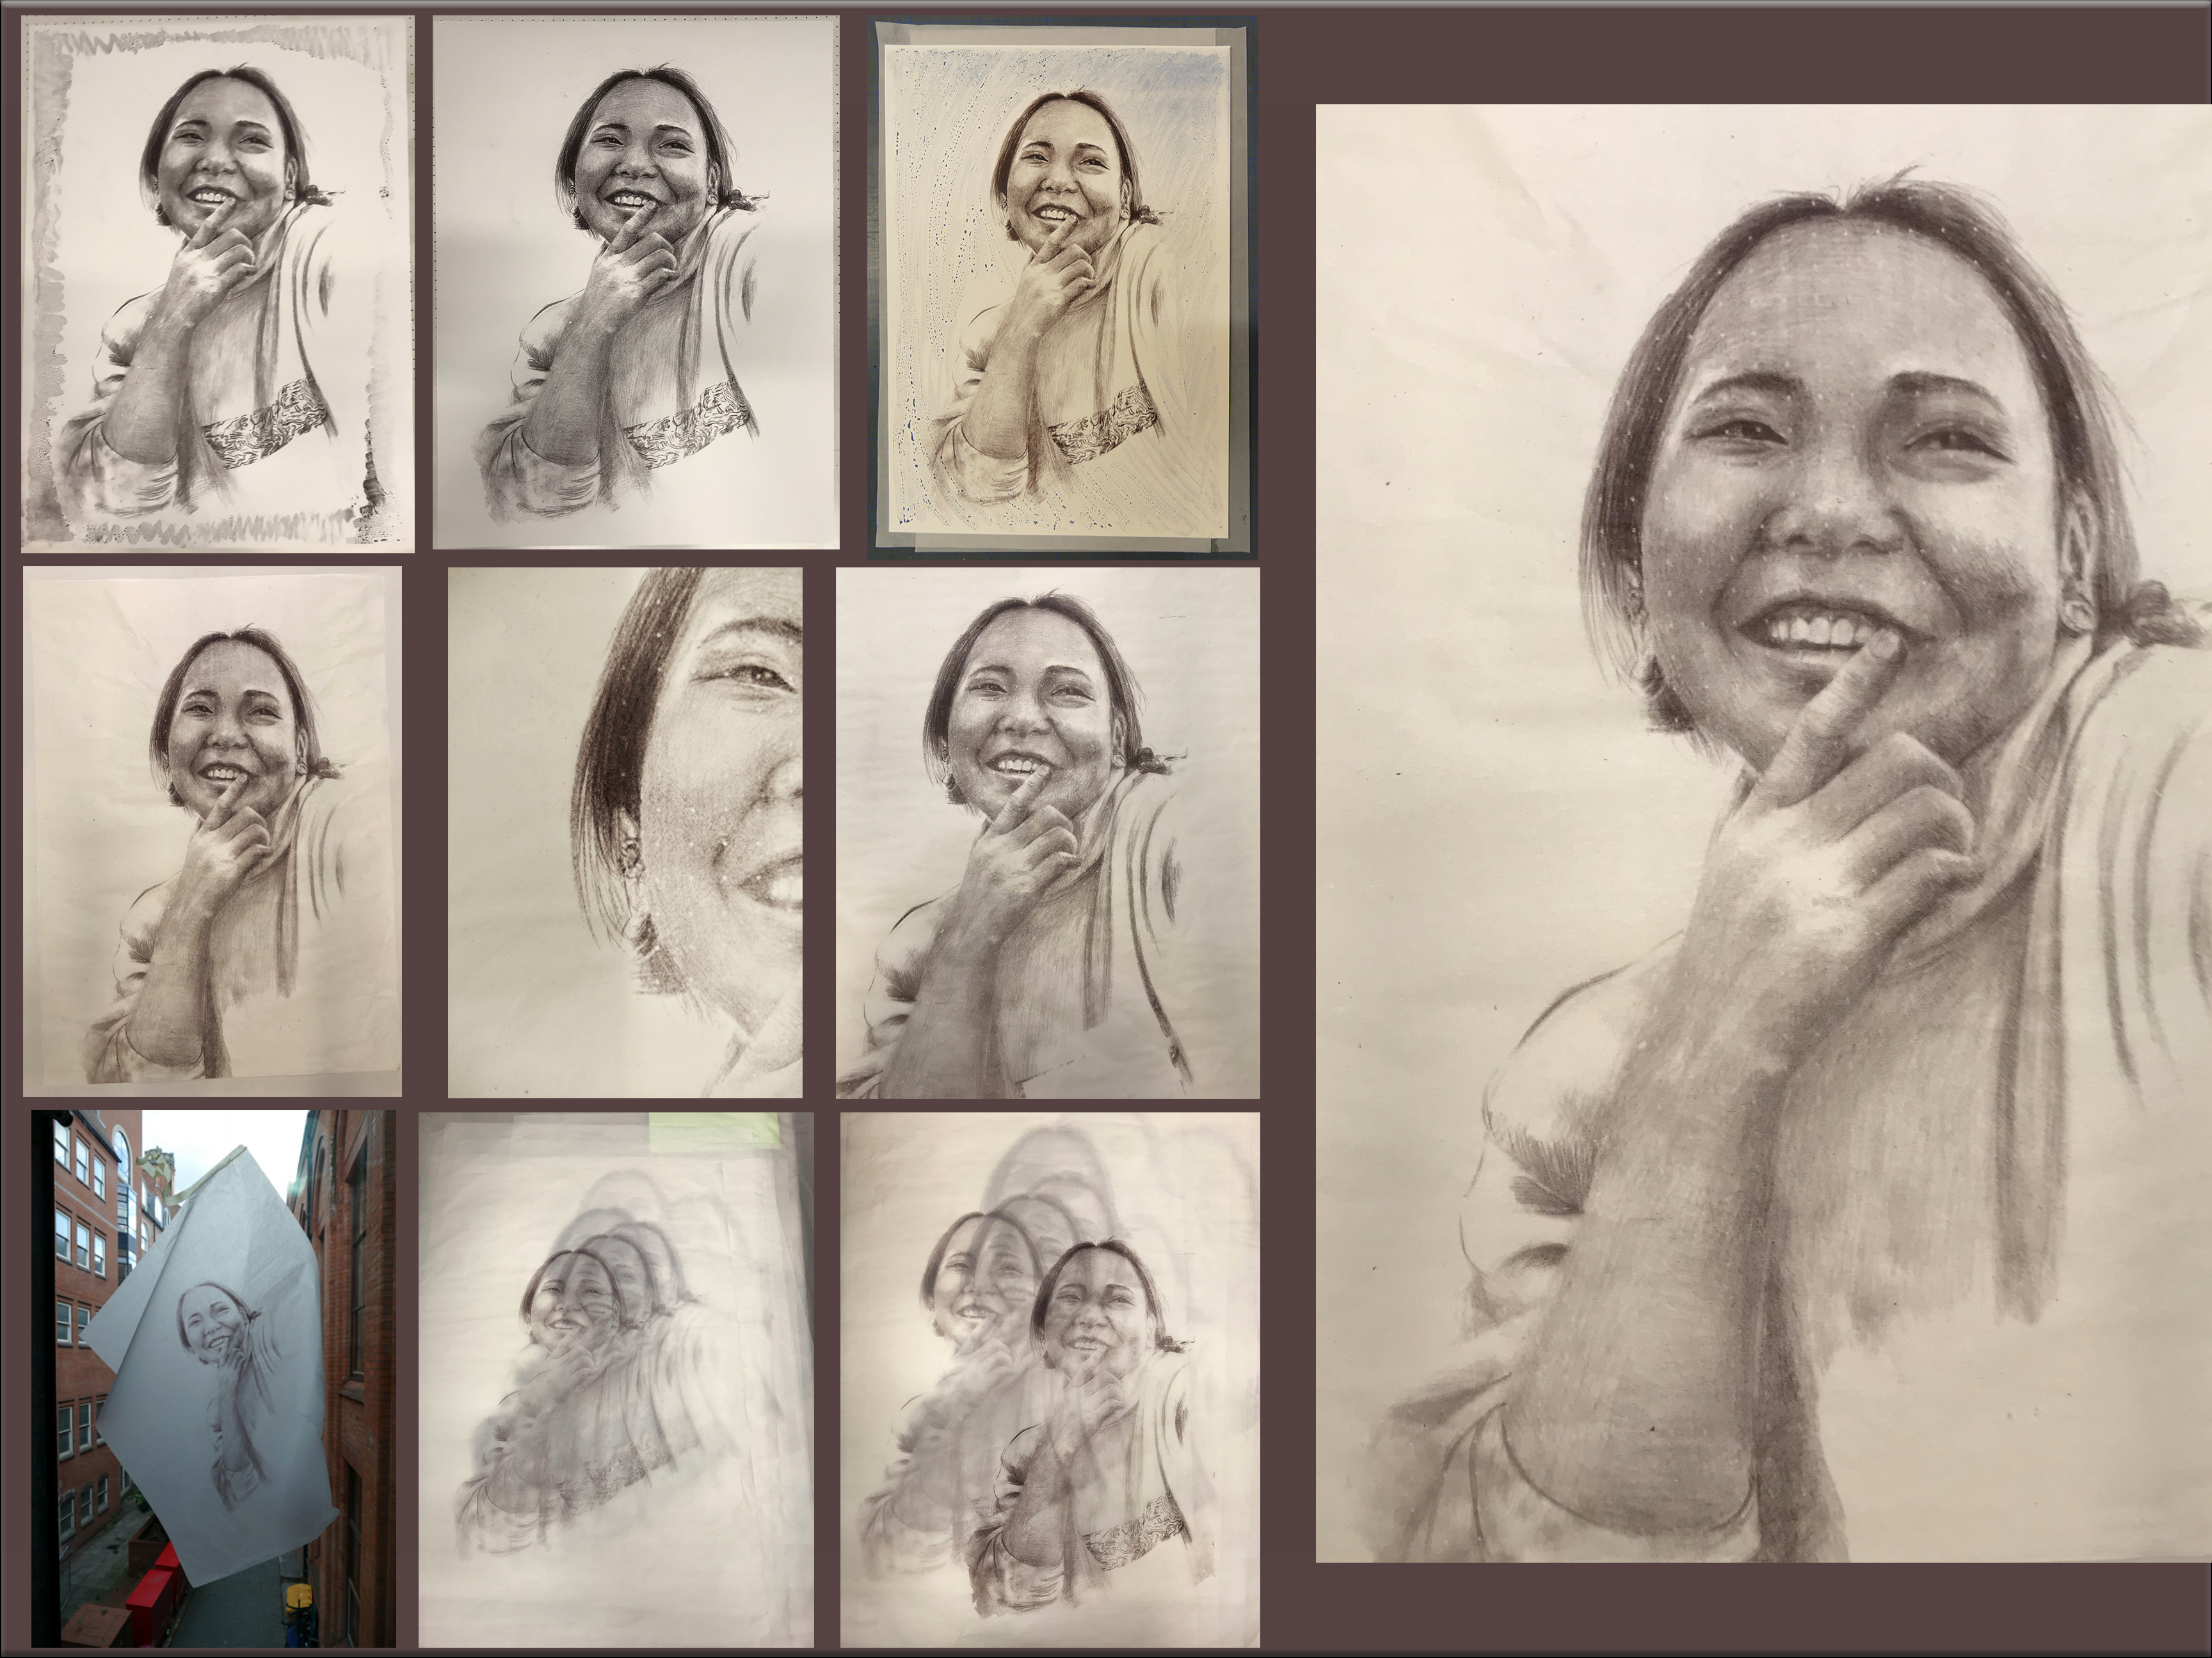



Consenting Adults
Portraiture and Discreet Photography
Lived Experience Symposium
Huddersfield University June 14th 2019
Jonnie Turpie. Practice led PhD Research
Birmingham School of Art , BCU
Printsanew.jonnieturpie.com jonnie_turpie @jturpie

Slide 2
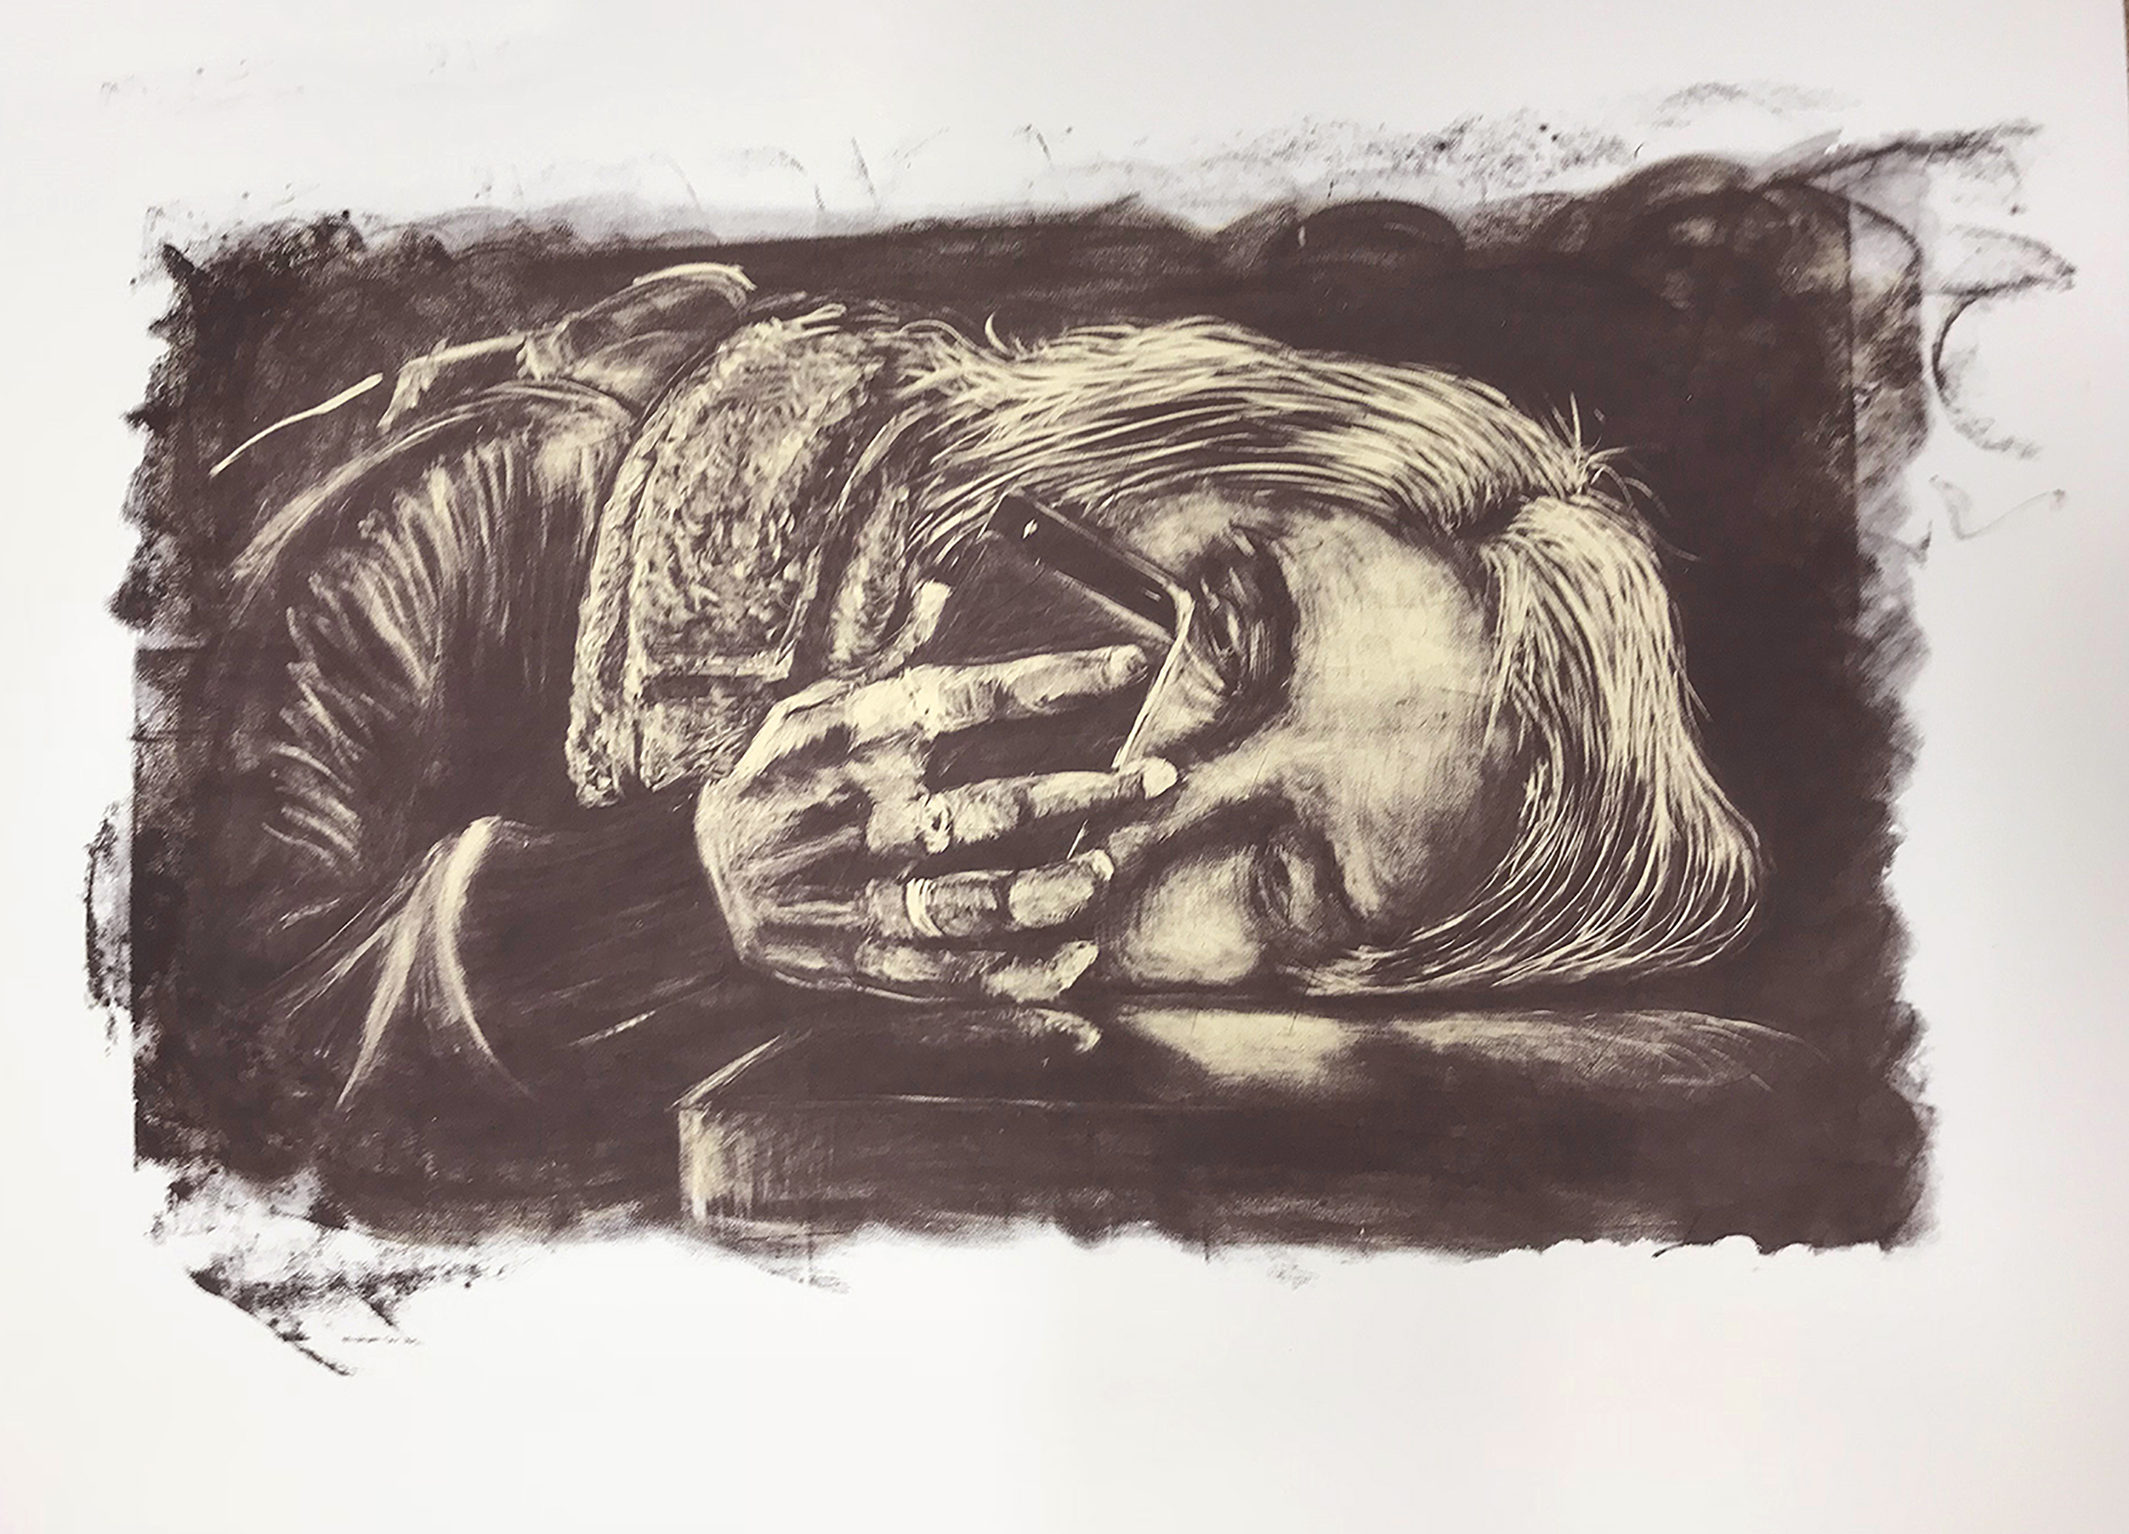
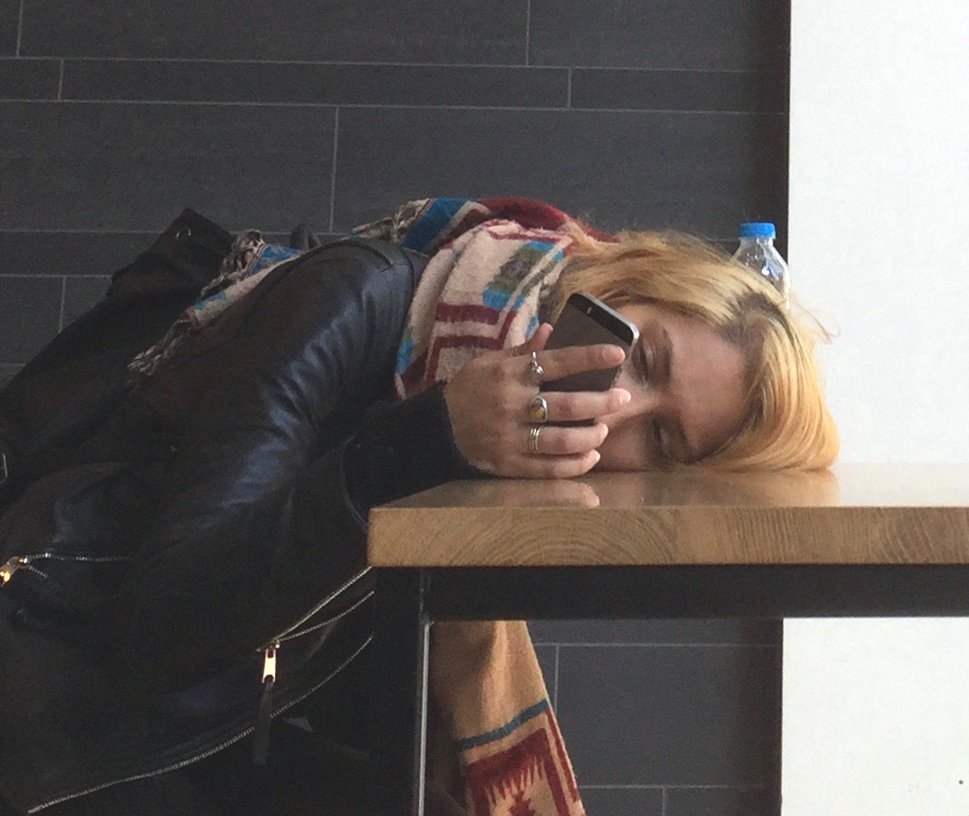
√
Phone viewing. MAC Arts Centre.
‘NAV’ Future Gazing. 20×26 Silkscreen duotone 2017

Slide 3
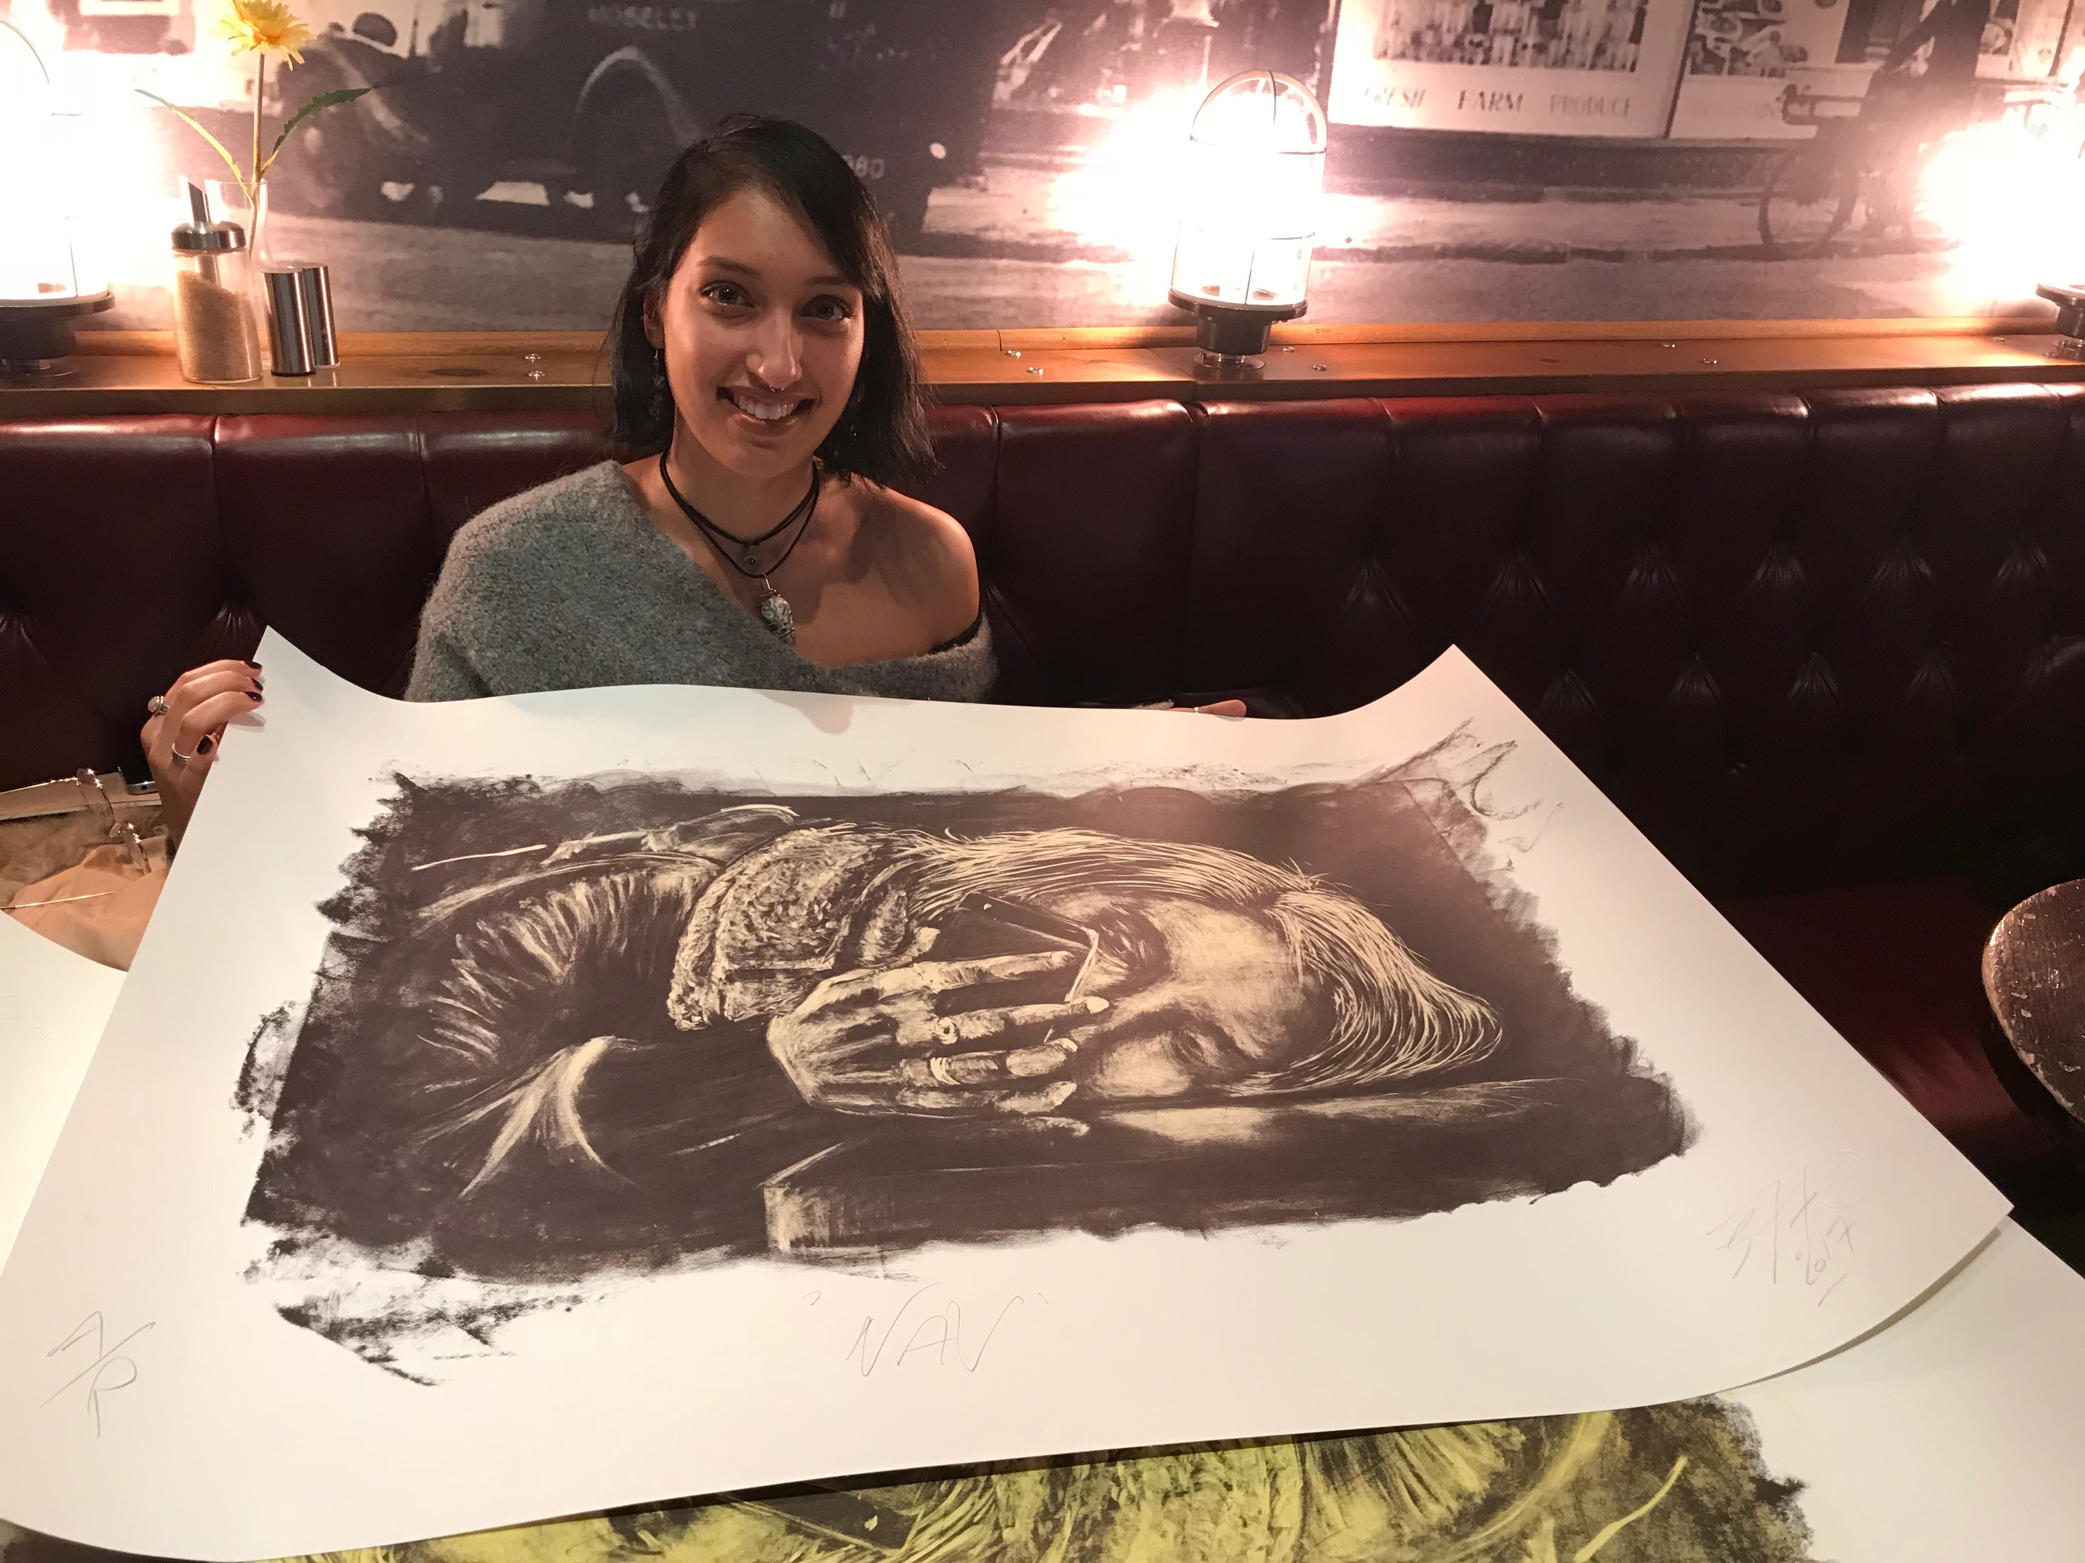
√
“This is insane and so random!! It’s beautiful. Please say more.”
jT “Im glad you like it. If you would like to see, and have, an original I’d be happy to get you one.”
Nav : “Super cool! I’d love one. It’s so crazy to see that when you’re own world like that, you can inspire someone to want to create!”
NAV with ‘NAV’

Slide 4
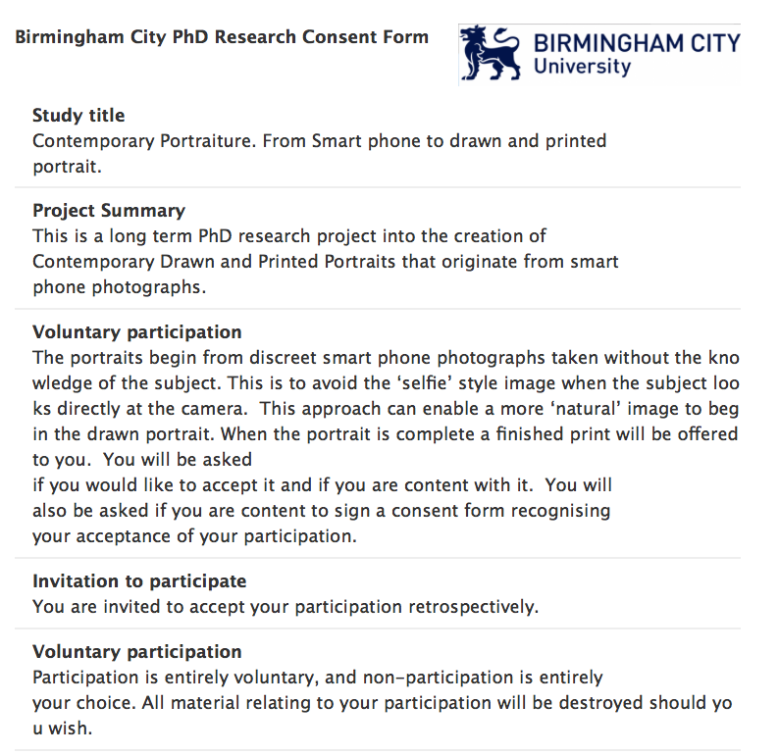

Slide 5
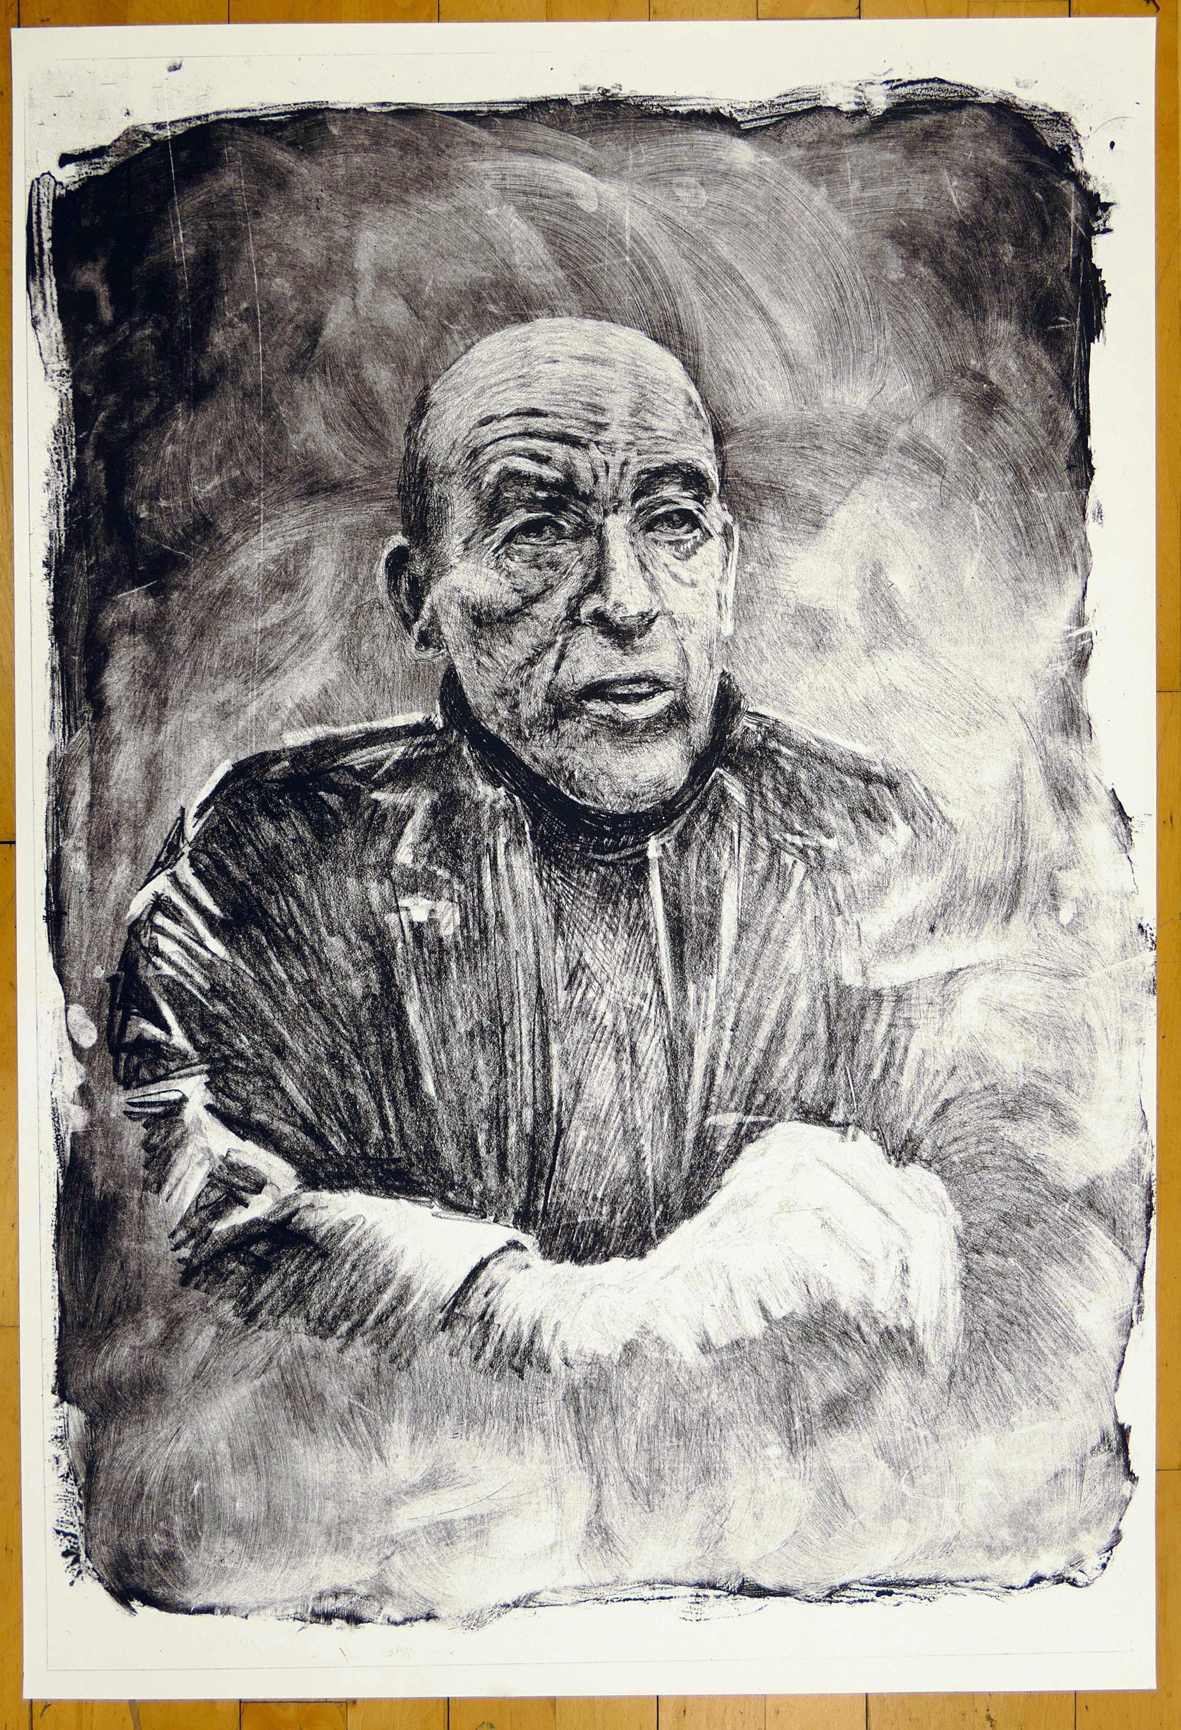
Kevin Atherton.
Artist 2019.
A1 Silk Screen.

Slide 6
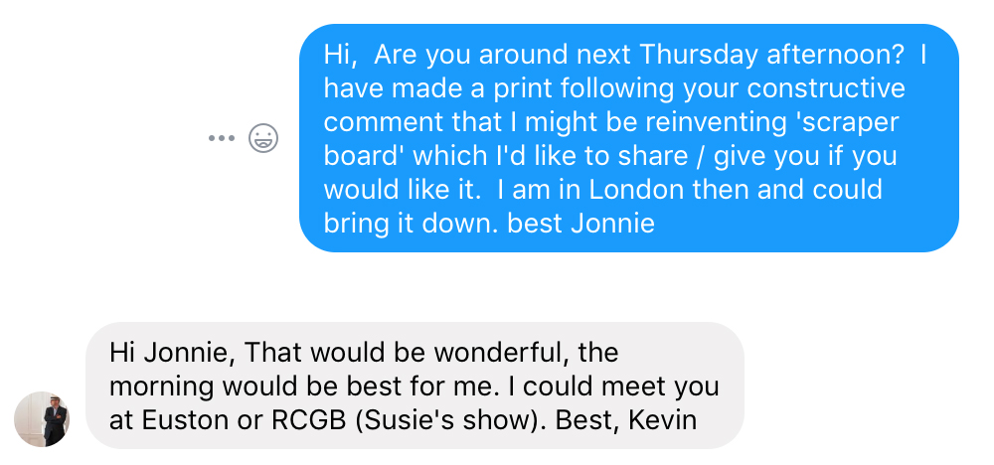
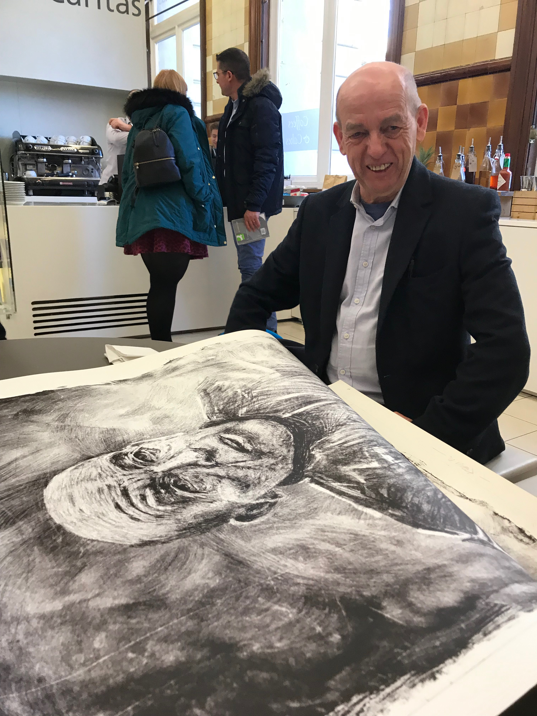
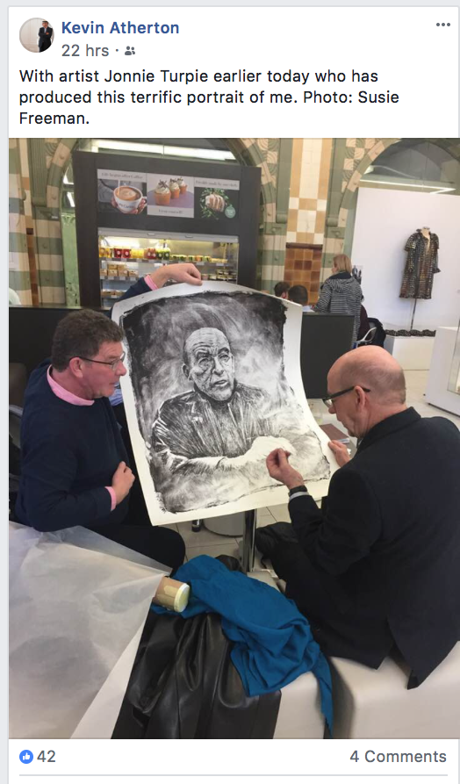
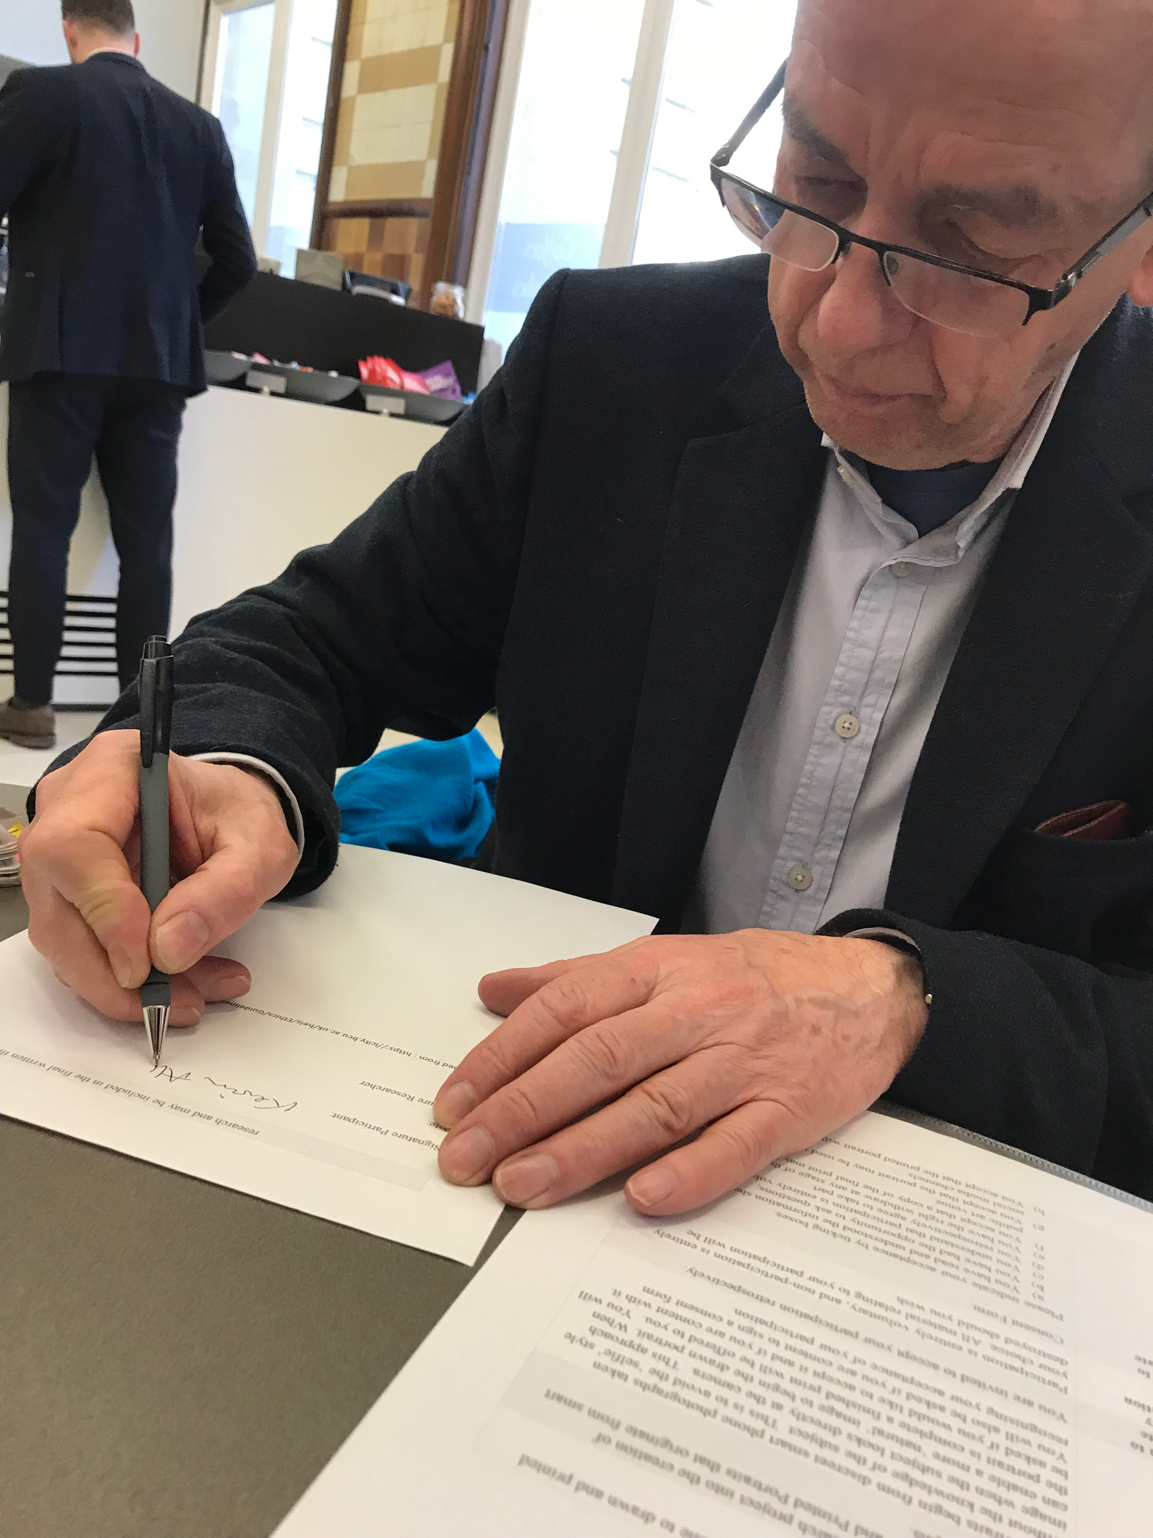

Slide 7
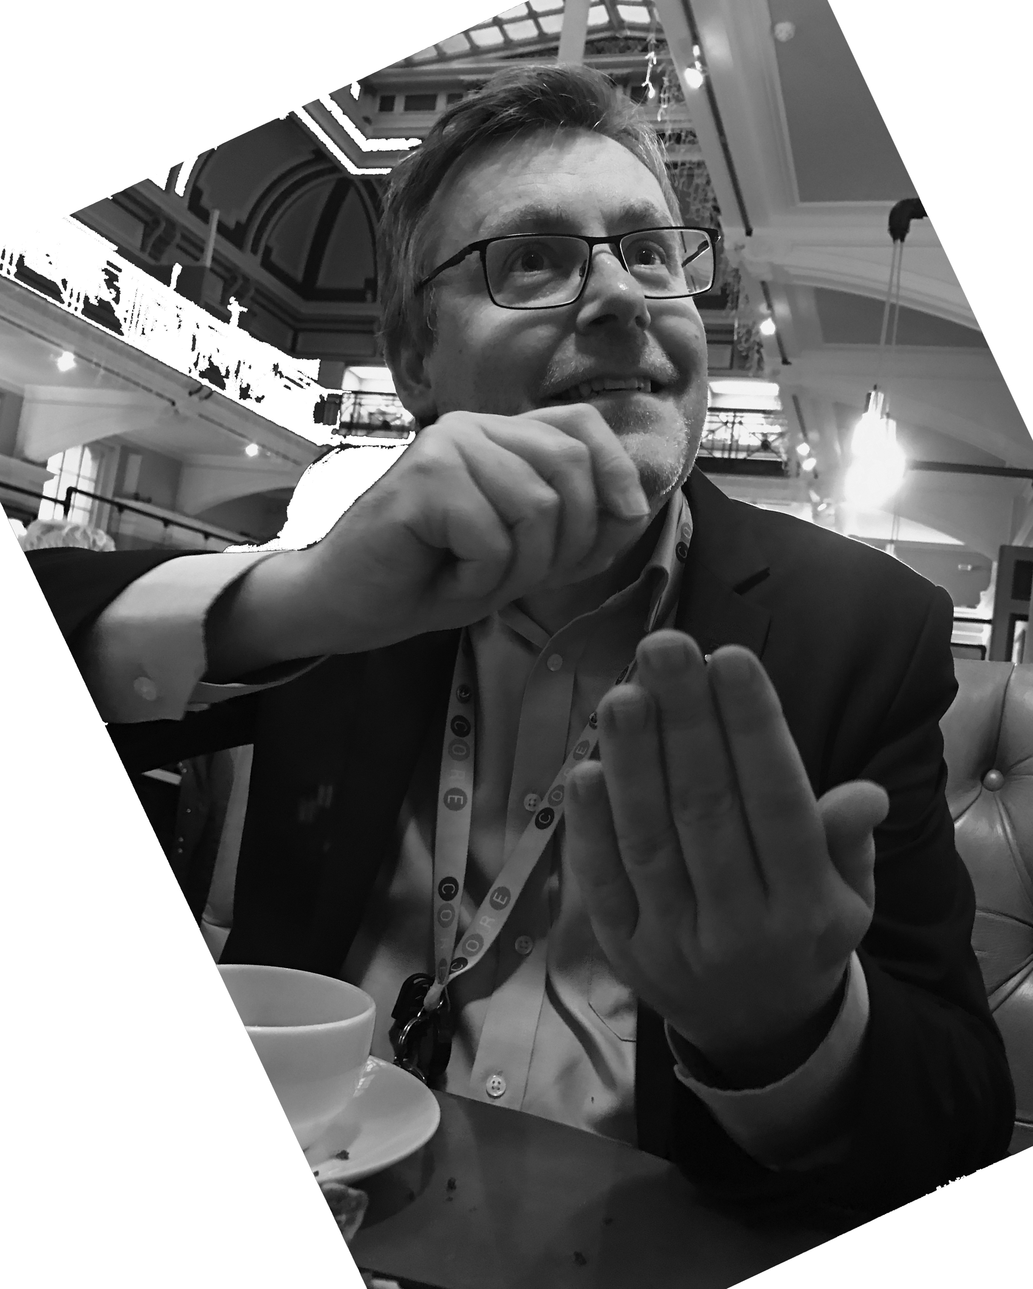
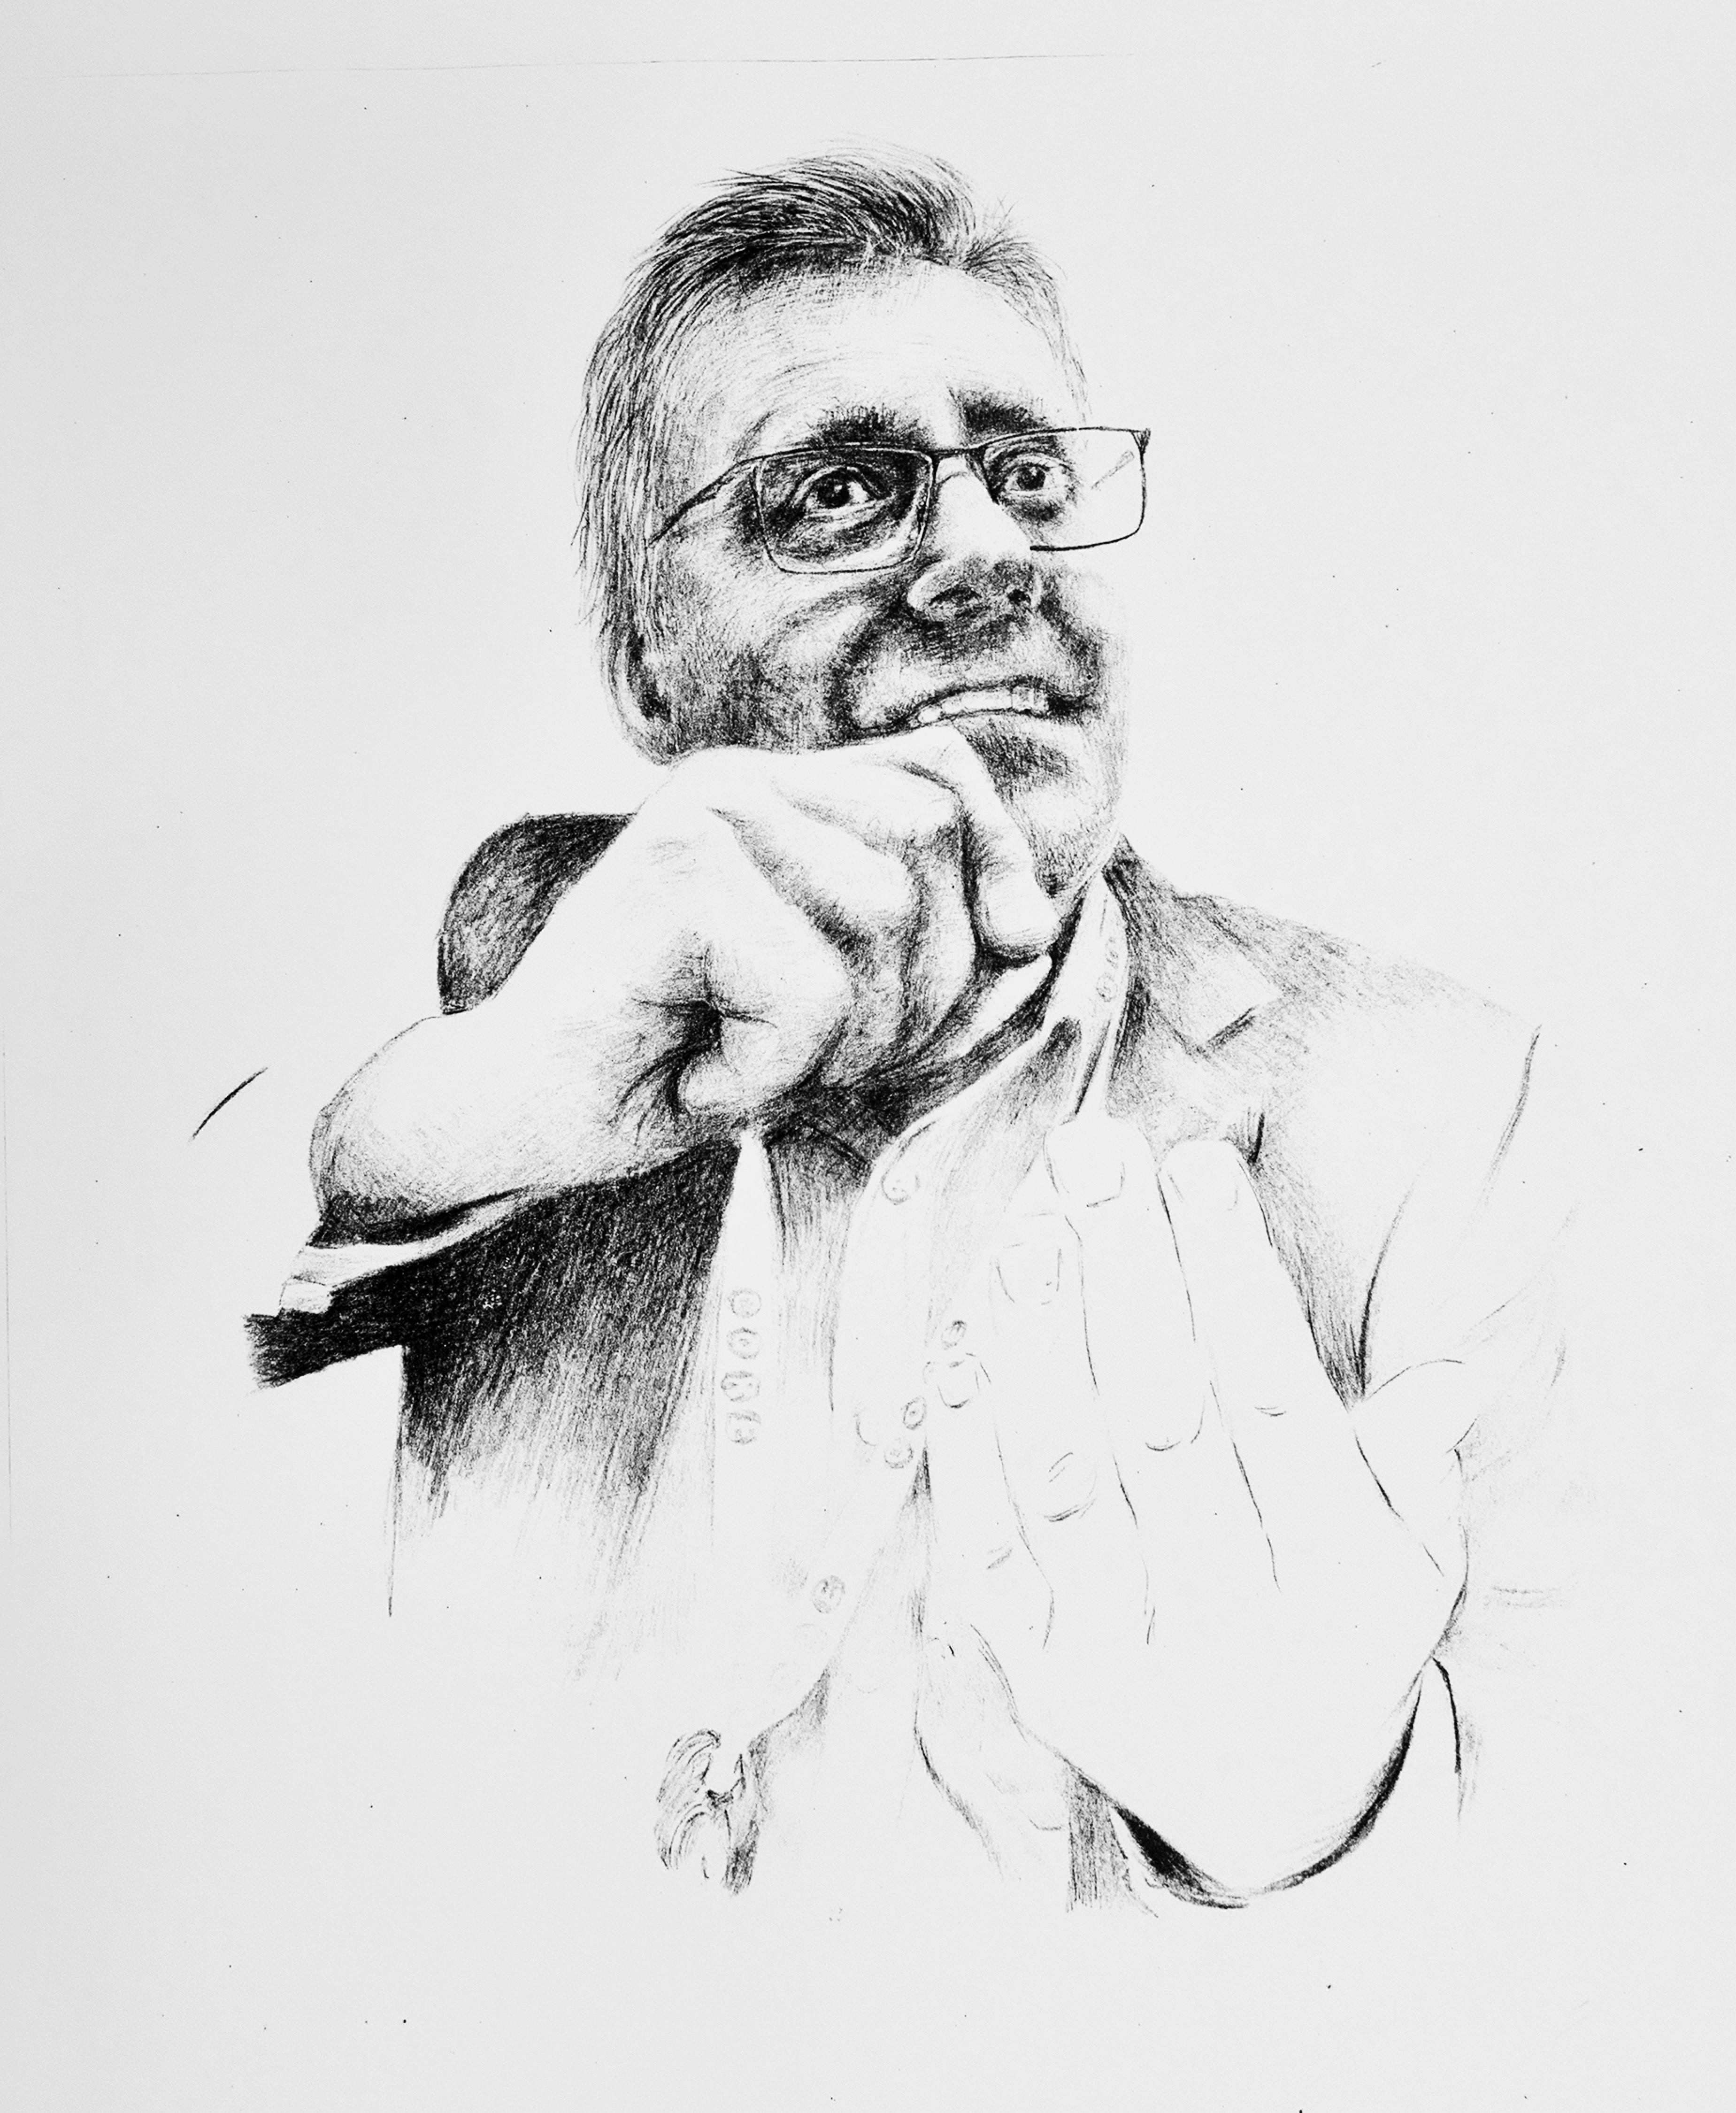
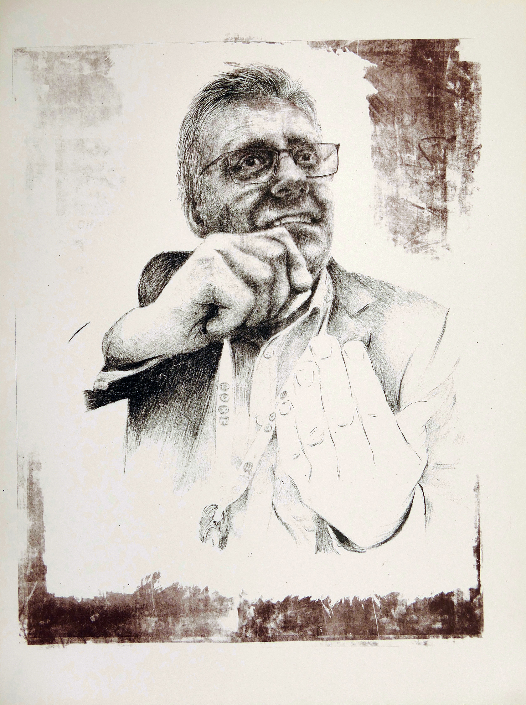
Adrian Paker. Educator
2019. A1 Silk Screen, duotone.

Slide 8
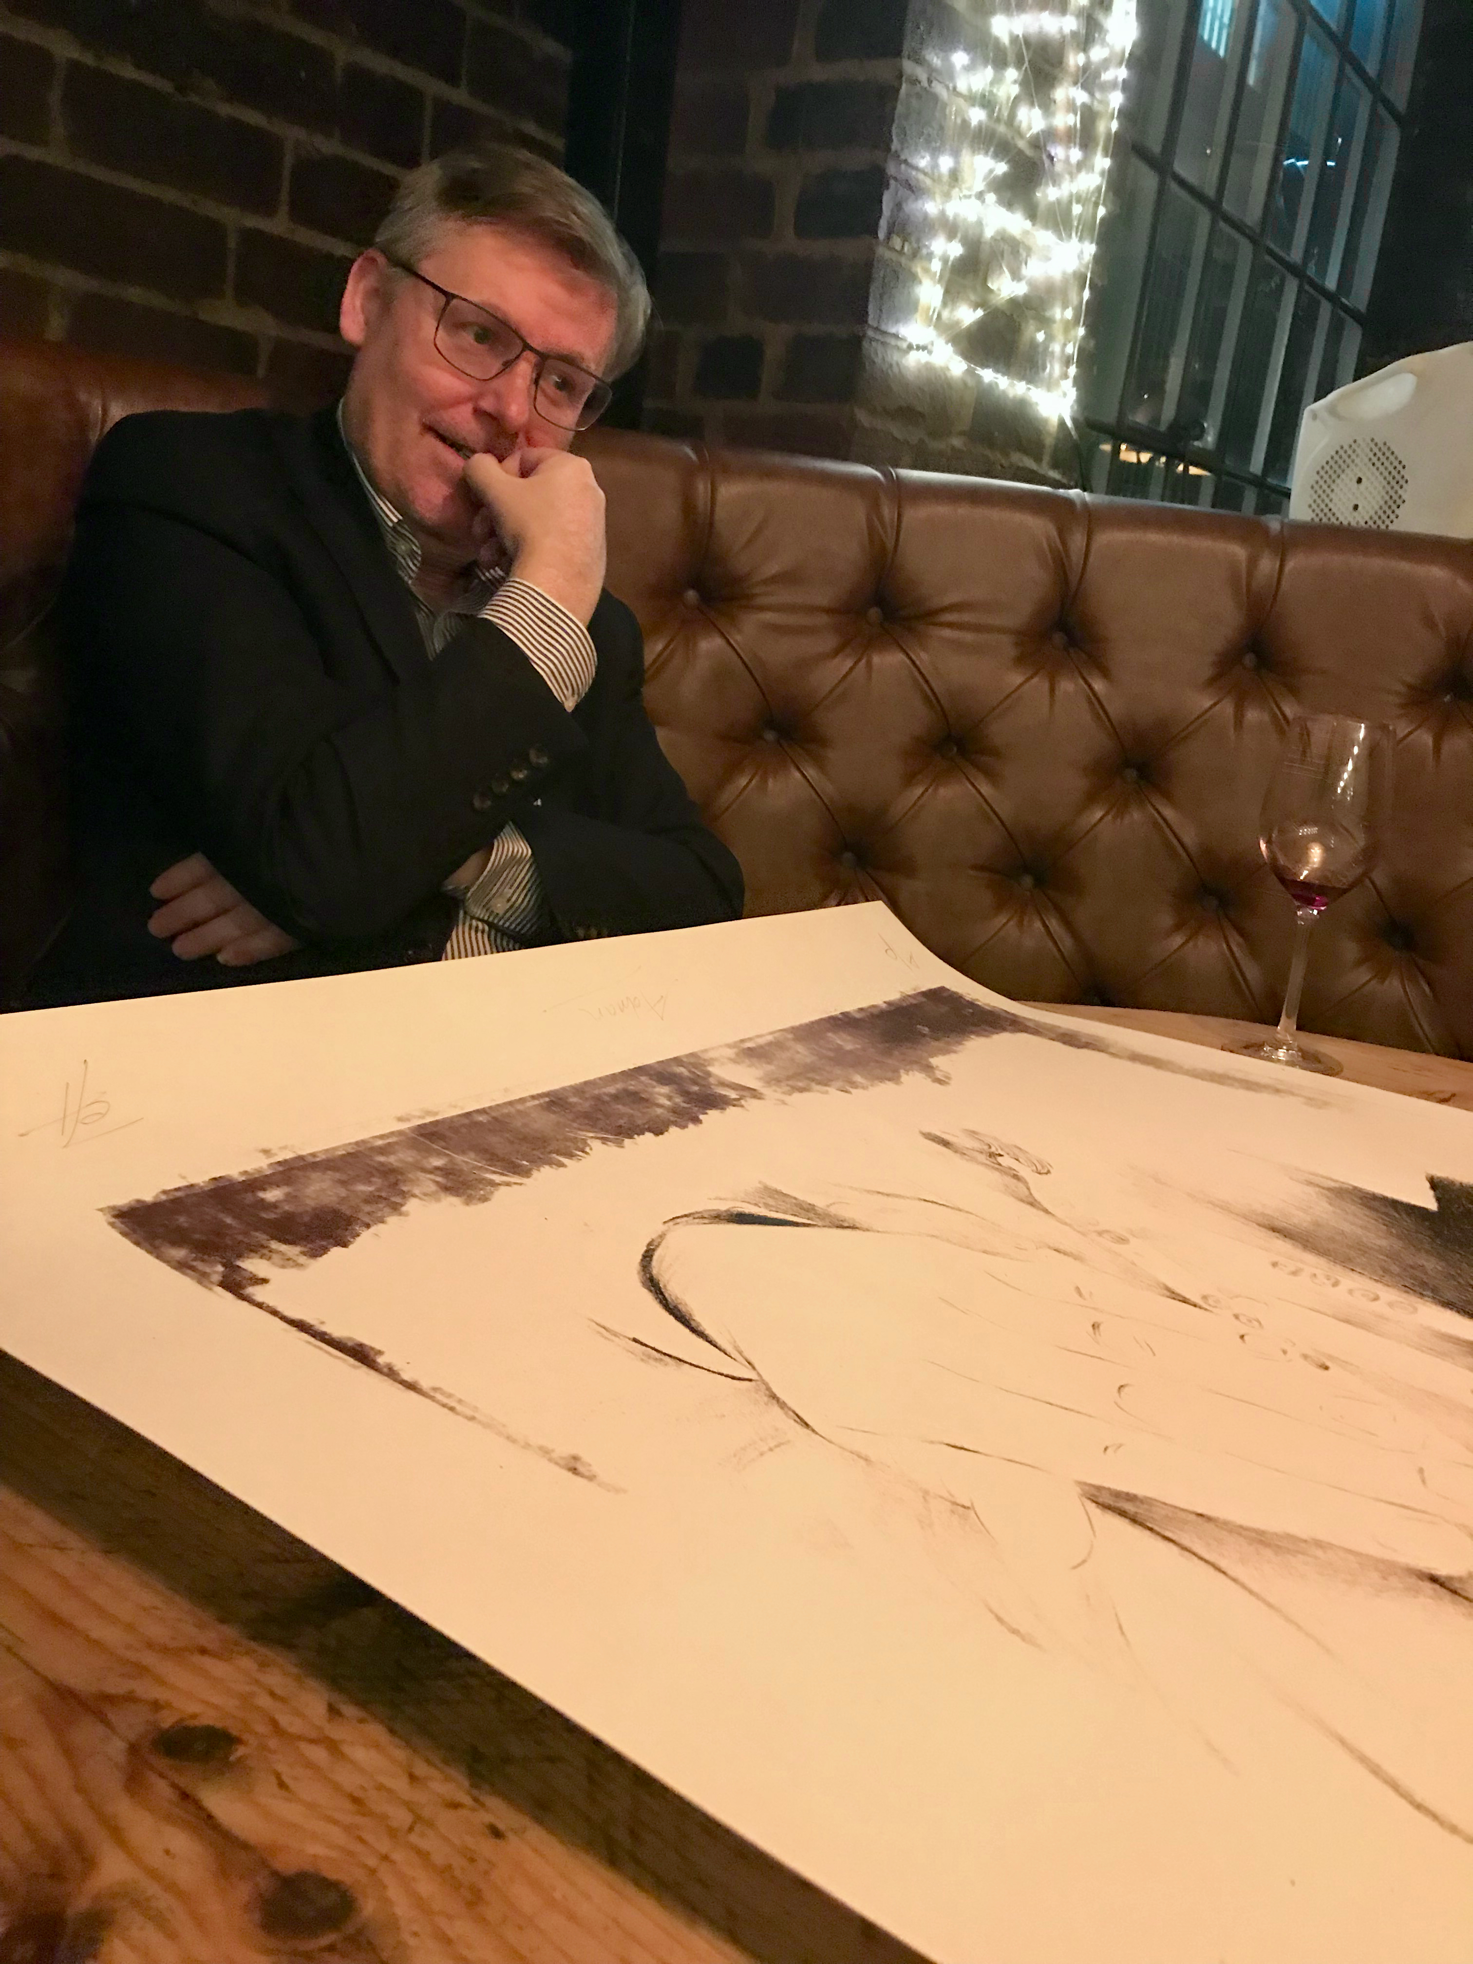
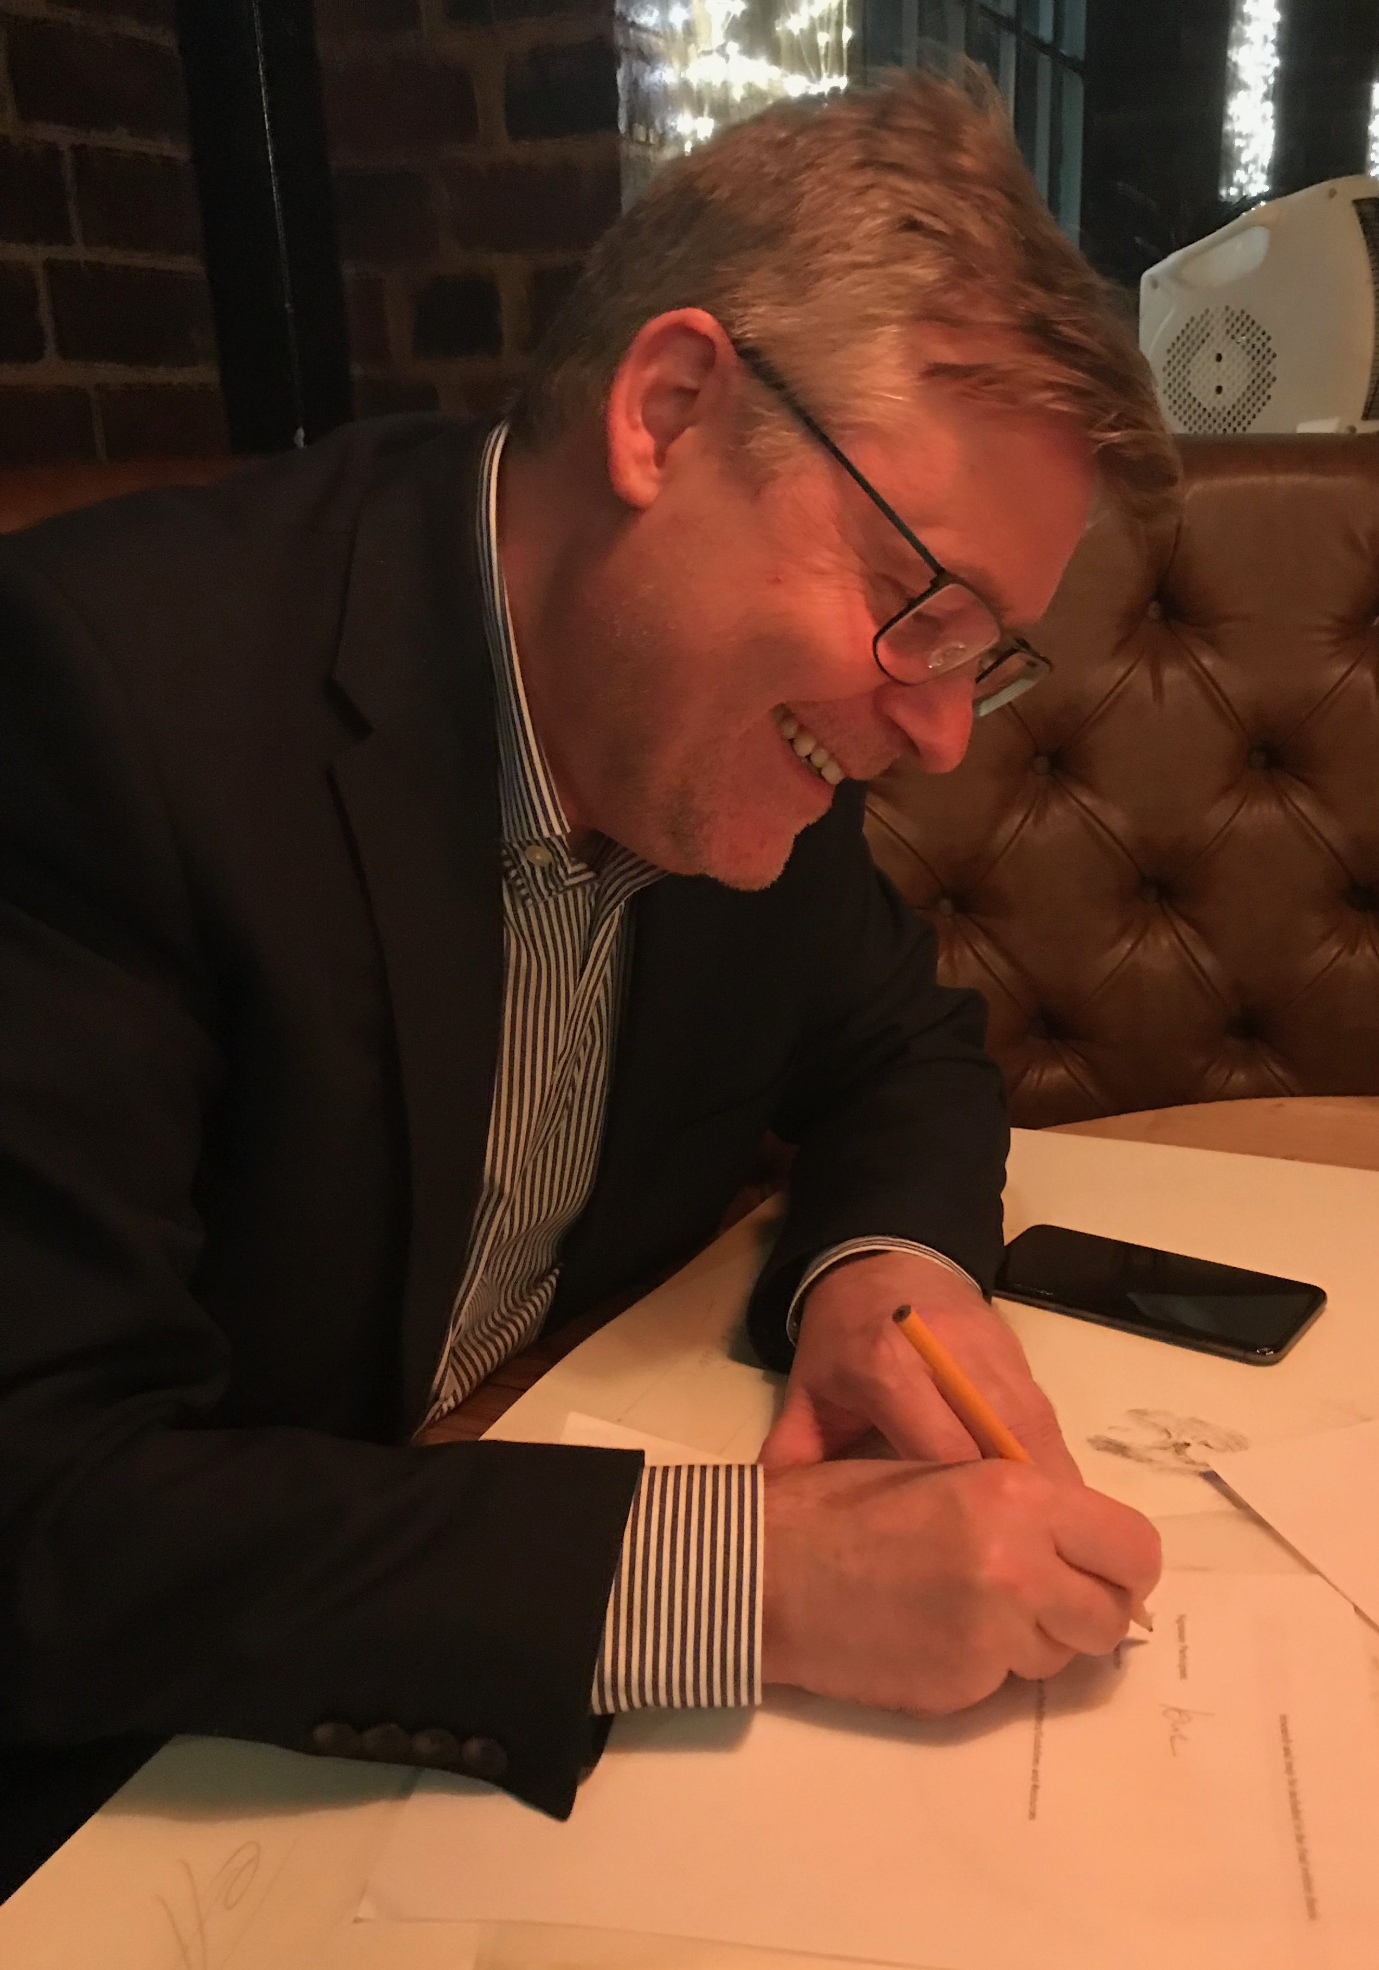
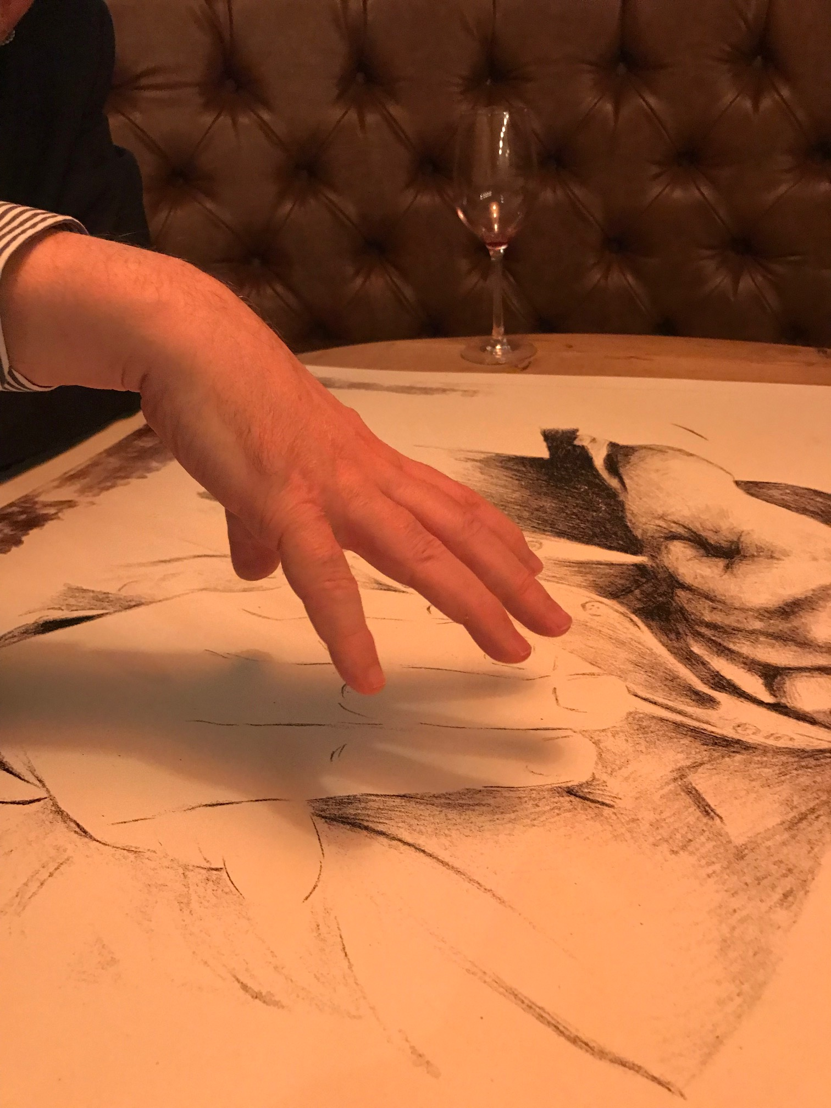

Slide 9
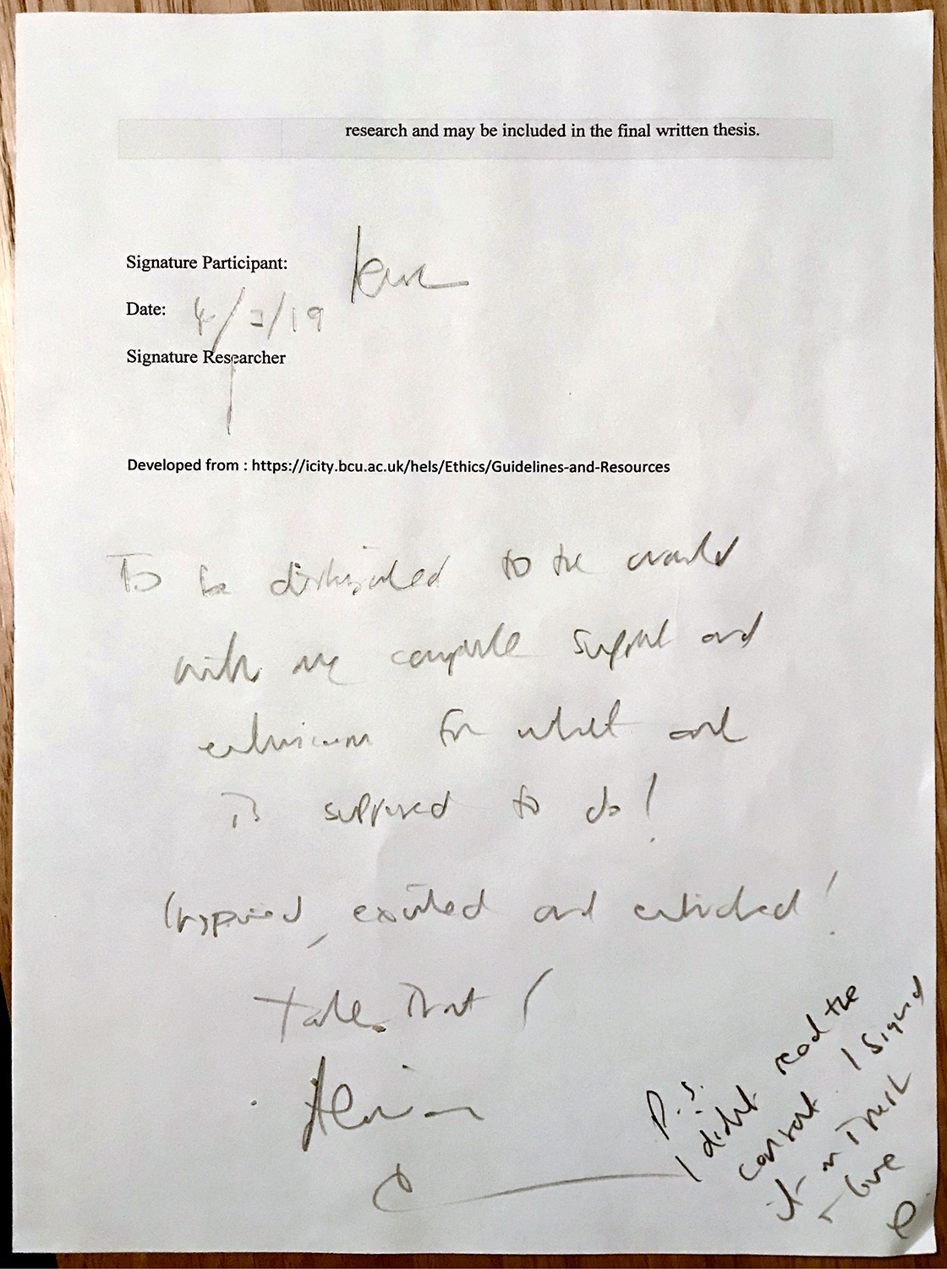
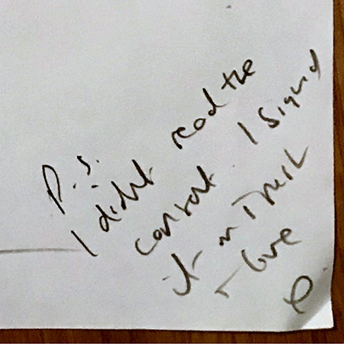

Slide 10
Consenting Adults
Portraiture and Discreet Photography
Lived Experience Symposium
Huddersfield University June 14th 2019
Thank You
Jonnie Turpie. Practice led PhD Research
Birmingham School of Art , BCU
Printsanew.jonnieturpie.com jonnie_turpie @jturpie

